Slide 1

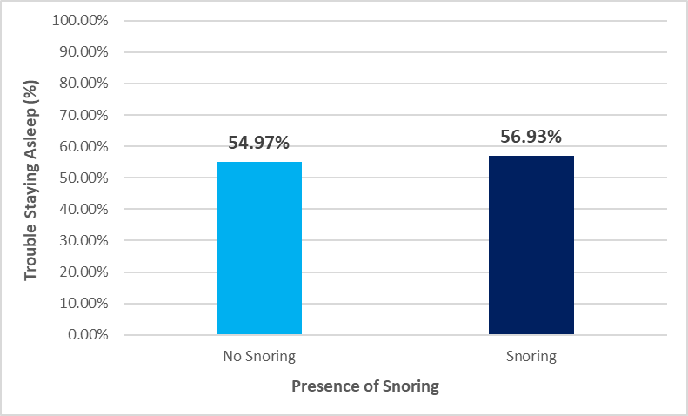


The Sleep Study: Snoring, Difficulties, and Duration
Zakaria Wilson
Thiel College
Research Mentor: Dr. Kristel M. Gallagher
5
Discussion
4
Results
It seems sleep is not so immediately understood and logical as once thought, since what appeared to be an obvious potential correlation between snoring and trouble staying asleep turned out to be not statistically significant. Additionally, while snoring was associated with statistically significant lower sleep times, the means for those who snored and those who did not were still both at 8 hours, with the difference coming down to minutes. This may be a difference that realistically does not impact someone’s quality of life. What this means is that snoring, while still a symptom of sleep-disordered breathing, is not going to ruin someone’s ability to sleep, and so efforts on improving sleep may want to focus on other potential factors. In fact, with anxiety acting as a moderating variable for the relationship between snoring and time slept, it may prove a more meaningful measure of an individual’s quality of sleep and overall impact on their health. Future research could go in one of two directions: either test other sleep assumptions to further support or debunk them (such as how snoring was not related to trouble staying asleep) or test new variables with time slept to find a more impactful relationship that could be used to further increase sleep quality. Simply understanding what effects sleep is still extremely important because of the links between poor sleep and depression, as discussed by Zhang’s research (2023).
1
Research Questions
Univariate Statistics
The snoring variable only allowed for yes or no responses, with 51.4% of those responses being yes, and the other 48.6% of responses being no.
The mean value for average time slept was 8.6 hours, with a standard deviation of 2.4 hours. Additionally, the median and mode were 8 hours of sleep, with a maximum sleep of 23.5 hours and a minimum sleep of 2 hours, producing a range of 21.5 hours.
The trouble staying asleep variable allowed for four different response options, ranging from “never in the past 4 weeks” to “5 or more times a week.” Most responses were “never” at 44.1%, with fewer and fewer responses as number of troubles increased, except for “5 or more” being slightly more common than the previous response of “3 or 4 times a week.”
Bivariate Statistics
An analysis of variance was conducted to examine the relationship between snoring and average time slept in hours, and it was significant F (1, 5048) = 13.45, p = .0002. The mean average sleep time of respondents who did not snore was 8.7 hours (SD = 2.5), while the mean average sleep time of respondents who snored was 8.4 (SD = 2.4).
A chi square test of independence revealed that snoring and trouble staying asleep were not significantly associated, X² = 1.4, 1 df, p = .236. Specifically, 54.97% of respondents who reported having trouble staying asleep did not snore compared to 56.93% of respondents who snored and reported having trouble staying asleep (Figure 1).
Multivariate Statistics
Anxiety was tested as a potential moderating variable in the significant association between snoring and average time slept. This association became not significant for respondents with anxiety (p = .72). However, the association remained significant for those who did not have anxiety (p = .0002). Based on these findings, anxiety was determined to be a moderating variable.
Is snoring associated with how long one sleeps on the average night?
Is snoring associated with trouble staying asleep?
2
Background Research
In sleep-related research (Patel et al., 2008), college students were interviewed on their snoring habits. Roughly 30% of them snored, with men snoring more than women. Since snoring is one of the main symptoms of sleep-disordered breathing, it is relevant to study and understanding snoring habits.
More research on sleep disturbances revealed that across an individual’s lifespan, there is a 60.8% chance of experiencing clinically significant sleep disturbances (Karlovich et al., 2023). With sleep disturbance being so prevalent, it is a valuable subject for further research, as well as other sleep trends.
A study found a significant association between a sleep duration of less than 6 hours or more than 8 hours and depression, as well as snoring and depression (Zhang et al., 2023). While the possible association between sleep and depression was not the focus of this research, this only further emphasizes the importance of understanding general sleep trends.
3
Method
6
References
Sample
This project utilized secondary data analysis to answer the research questions. The data was drawn from a publicly available sample of respondents from Wave IV of the National Longitudinal Study of Adolescent to Adult Health (Add Health). Add Health is a nationally representative sample of adults living in all 50 states of the United States. Wave IV was collected in 2008 and contains 5,114 respondents aged 25-34 years. Of those, 46% are male and 54% are female. The race breakdown includes approximately 72% white, 24% black or African American, 1% American Indian or Alaska Native, and 3% Asian or Pacific Islander.
Measures
Variables used in this research include:
Times when waking up and going to bed on both busy and not busy days, and a formula using these variables for calculating time slept.
How often one had trouble falling asleep, as well as staying asleep.
If a respondent snores or not.
If a respondent was diagnosed with anxiety or not.
Karlovich, A. R., Shaughnessy, S., Simmons, K., & Evans, S. C. (2023). Toward greater specificity in the nonspecific: Estimating the prevalence of diagnostic irritability and sleep symptoms in adolescents. Journal of Psychopathology and Clinical Science, 132(7), 820–832.
Patel, M., Tran, D., Chakrabarti, A., Vasquez, A., Gilbert, P., & Davidson, T. (2008). Prevalence of snoring in college students. Journal of American College Health, 57(1), 45–52.
Zhang, X., Li, G., Shi, C., & Sun, Y. (2023). Associations of sleep duration, daytime napping, and snoring with depression in rural China: A cross-sectional study. BMC Public Health, 23(1), 1–12.
Figure 1. Snoring and Trouble Staying Asleep. There was not a significant relationship between the presence of snoring and the percentage of respondents who suffered from trouble staying asleep.
Research conducted
and presented as part of the
Passion Driven Statistics course
at Thiel College in Fall 2023.

