Slide 1
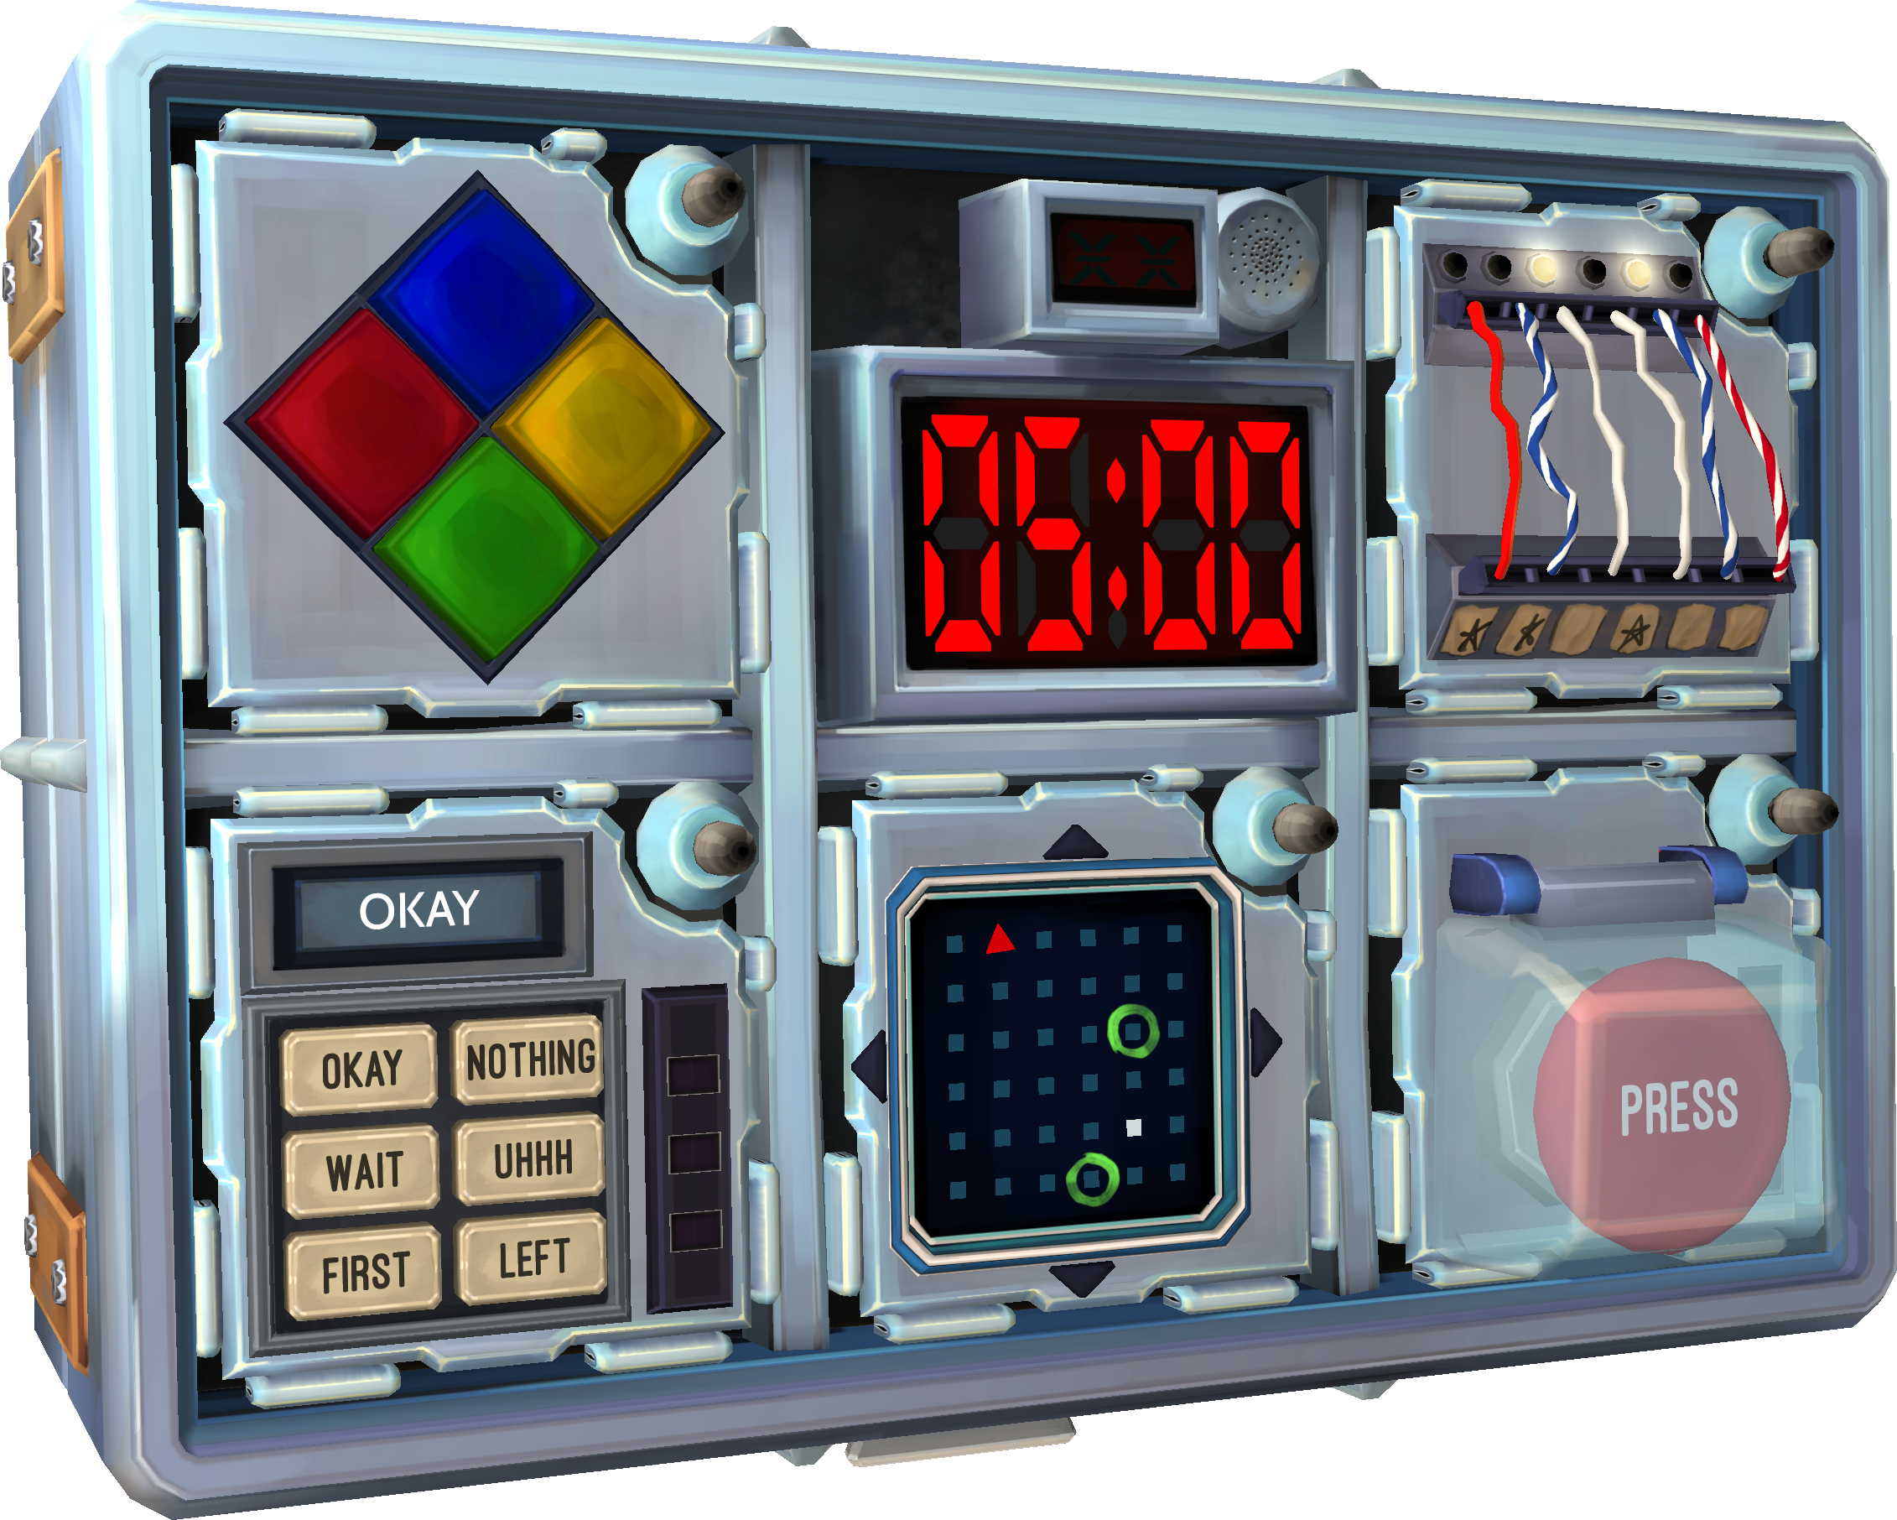


Teamwork persists through COVID-19 isolation!
In-person collaboration no better than Remote!
Introduction
Method
Results
Discussion
Do presence-based, nonverbal communication cues (such as body language and facial expressions) boost performance on collaborative tasks?
Given the recent shift to online classrooms and workspaces, it is important to consider how communication and teamwork may have been impacted.
Kroencke et al. (2023) found that in-person social interactions made a much larger impact on well-being than remote interactions.
However, Zhao et al. (2023) discovered that teams forced to only use body language to perform collaborative tasks did not perform better than those that were not forced, even when the final task removed the restriction of forced body language.
Two conditions: face-to-face (in-person) vs. over the phone (remote).
Sixteen undergraduate students total, 8 teams (4 per condition), all randomized by sign-up times. Demographics include 37.5% males and 62.5% females, with 87.5% Caucasian.
Answer survey questions to establish demographics, familiarity with the task, and familiarity with teammate.
Play computer game Keep Talking and Nobody Explodes, “The First Bomb.” Teams must communicate to correctly solve wires, button, and symbols modules.
Record time remaining on the bomb from results screen. Manually track strikes made on successful attempt and number of attempts for successful defusal.
An independent samples t-test was computed to assess the effect of method of communication on collaborative ability. There was not a significant effect of method of communication on collaborative ability, t (14) = -.289, p = .777, with face-to-face and over the phone not having significantly different values. The mean of time remaining for face-to-face was 69 seconds (SD = 41), while the mean of time remaining for over the phone was 74 seconds (SD = 35) as shown in Figure 1.
Based on the results of this study, there is no evidence to suggest that non-verbal communication cues impact collaborative ability. This reflects the results found in Zhao’s (2023) study, which has a very similar procedure and research question.
One potential limitation is that the collaborative task was perhaps too complex, and most successful attempts relied on lucky guesses. Additionally, the small sample size may have contributed to a lack of statistical power needed to find a true effect.
The current study raises the question of why the over the phone condition performed better, even if not significantly. Future research should examine this result by having both conditions communicate remotely through the phone, with one using a video call for body language.
References
Kroencke, L., Harari, G. M., Back, M. D., & Wagner, J. (2023). Well-being in social interactions: Examining personality-situation dynamics in face-to-face and computer-mediated communication. Journal of Personality and Social Psychology, 124(2), 437–460. MEDLINE.
Zhao, F., Wood, A., Mutlu, B., & Niedenthal, P. (2023). Faces synchronize when communication through spoken language is prevented. Emotion (Washington, D.C.), 23(1), 87–96. MEDLINE.
Figure 1. Mean time remaining for both conditions.
Keep Talking and Nobody Explodes
Primary Researcher: Zakaria Wilson Research Mentor: Dr. Kristel Gallagher
Research conducted and presented as part of Experimental Social Psychology at Thiel College in Spring 2023.

