Slide 1



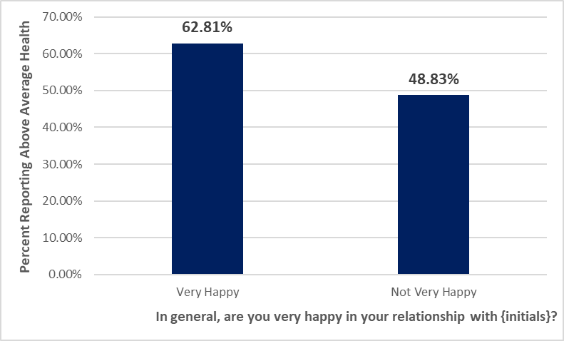
How General Health Perceptions are Related to Individual
Aspects of Health in Adults in the United States
Zakaria D. Wilson and Research Mentor Dr. Kristel M. Gallagher
Research Questions
Method (Continued)
1. Is there a relationship between how adults report their height and weight, and their measured BMI?
2. Is there an association between perceptions of general health and relationship satisfaction in adults?
3. Are adults who are satisfied with their job more likely to report higher perceptions of general health?
Measures
Relevant survey questions include:
“How tall are you in feet?”
“How tall are you in inches?”
“What is your current weight in pounds?”
Measured body mass index.
“In general, how is your health?”
  Increasing scale from one to five.
“In general, how happy are you in your relationship with {initials}?”
  Increasing scale from zero to three, zero meaning single.
“How satisfied (are/were) you with this job, as a whole?”
  Increasing scale from zero to five, zero meaning unemployed.
“How do you think of yourself in terms of weight?”
  Increasing scale from one to five.
Background Research
Due to the variety of topics, several different sources were gathered to provide information and context. Their findings are as follows:
1. In a study performed on college students, results found that when students had to try to estimate their own BMIs, their values generally came out lower than what their measured BMIs were. Additionally, those that were more aware of their health habits (such as diet and exercise) tended to be more accurate in their estimations (Kenedy, Wiedenman, Ball, Dinkel, Akehi, & Bice, 2017).
2. When examining the perceptions of aging in older married couples, negative relationships correlated with lower perceptions of oneself. Inversely, a supportive spouse tended to improve self perceptions (Kim, Kim, Neupert, & Boerner, 2021).
3. The time of day that teachers work has a relationship with their stress levels and perceptions of their health. The more unusually early or late a teacher was working, the higher their stress typically was (Cladellas & Castelló, 2011).
Figure 1. Correlation between relationship satisfaction and perceptions of general health.
Results
Discussion
Univariate Statistics
The mean BMI derived from self-reported heights and weights was 28.4 with a standard deviation of 6.9 and a range of 51.4 units.
The mean measured BMI was 29.1 with a standard deviation of 7.5 and a range of 55.9 units.
57.53% of the participants reported having above average health.
69.41% of the participants with a relationship report being very happy in that relationship.
73.51% of the participants with jobs reported being at least somewhat satisfied with their job.
Bivariate Statistics
A correlation test was conducted to examine the relationship between reported BMI (derived from self-reported heights and weights) and measured BMI. The correlation was a statistically significant and the correlation was very strong and positive, r (4957) = .95, p < .0001.
A chi square test was conducted to examine the relationship between relationship satisfaction and perceptions of general health. The results showed a significant association between these variables, X² = 69.13, 1 df, p < .0001 (Figure 1).
A chi square test was conducted to examine the relationship between job satisfaction and perceptions of general health. The results showed a significant association between these variables, X² = 38.99, 1 df, p < .0001.
Multivariate Statistics
Perceptions of weight was found not to be a moderator when looking at the association between reported BMI and measured BMI. In the original correlation test, the association between the two variables was significant and still is significant in all categories when the third variable is added. As well as the p-value being similar, the correlation coefficient from the first test compared to all categories using the third variable are also similar, indicating that weight perceptions is not a moderator.
The results of this study suggest that there is a correlation between relationship satisfaction and perceptions of general health, job satisfaction and perceptions of general health, and how one reports their height and weight and their measured BMI. In other words, as several different aspects of health improve, overall health also increases. These results demonstrate that in order to feel healthy, one must feel happy and satisfied with multiple important aspects of their life, which might help individuals who are struggling with their health to tackle their problems one variable at a time to feel better with each step. Additionally, as the BMI correlation shows, individuals are accurate with reporting their own height and weight, which may demonstrate an understanding of general health. Future research could benefit by analyzing these and other factors together at once, to determine which are most important to feeling healthy.
Method
References
Sample
This project utilized secondary data analysis to answer the research questions. The data was drawn from a publicly available sample of respondents from Wave IV of the National Longitudinal Study of Adolescent to Adult Health (Add Health). Add Health is a nationally representative sample of adults living in all 50 states of the United States. Wave IV was collected in 2008 and contains 5,114 respondents aged 25-34 years. Of those, 46% are male and 54% are female. The race breakdown includes approximately 72% white, 24% black or African American, 1% American Indian or Alaska Native, and 3% Asian or Pacific Islander.
Cladellas, R., & Castelló, A. (2011). University professors’ stress and perceived state of health in relation to teaching schedules. Electronic Journal of Research in Educational Psychology, 9(1), 217–239.
Kenedy, K., Wiedenman, E. M., Ball, J. W., Dinkel, D., Akehi, K., & Bice, M. R. (2017). An examination of estimated BMI and perceived wellness among students at a Midsized Midwest University. American Journal of Health Studies, 32(3), 136–143.
Kim, Y. K., Kim, K., Neupert, S. D., & Boerner, K. (2021). Changes in married older adults’ self-perceptions of aging: The role of gender. Psychology and Aging.
Research conducted and presented as part of the Passion Driven Statistics course at Thiel College in Fall 2022.

